Slide 1

Impact Well Beyond Market Share: Synergy Between Standards and Open Source
Dr. Charles Severance
University of Michigan School of Information
www.dr-chuck.com
Transfer Summit - Oxford, UK - June 25, 2010

Slide 2
A Quest...
Fighting to empower teachers and learners to have a wide range of tools and technologies to use in teaching and learning without waiting for a vendor or their campus IT deparement to "get around to it". In a sense I want an "App Store" for software to support teaching and learning.

Slide 3
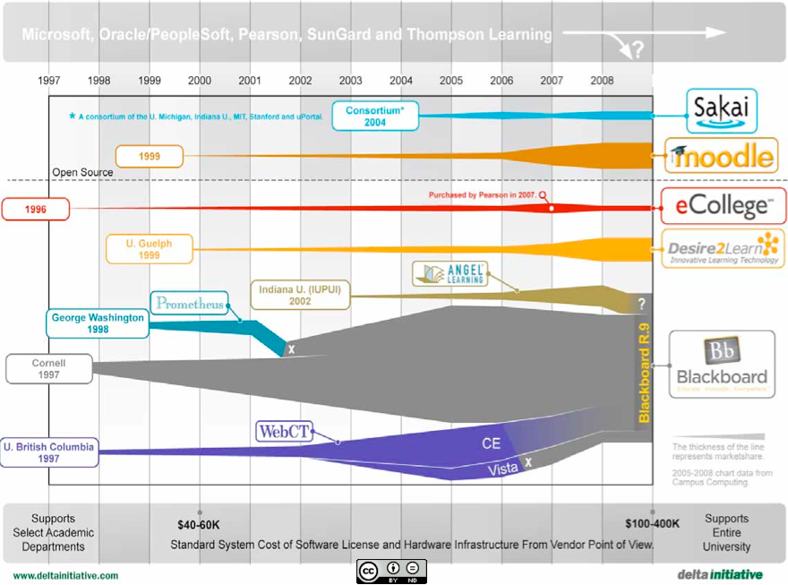


Slide 4

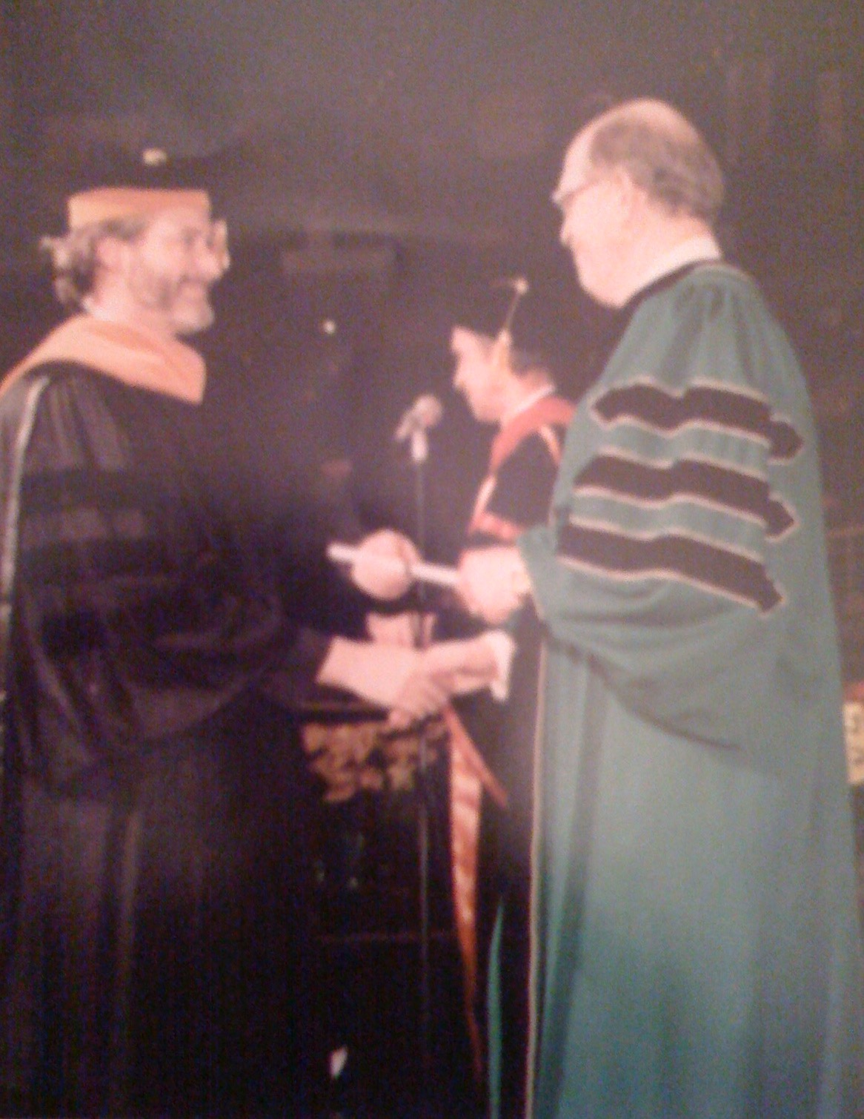
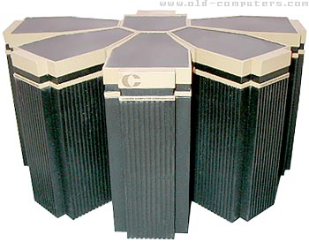
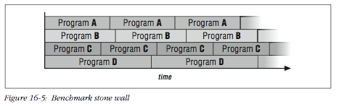
1996

Slide 5
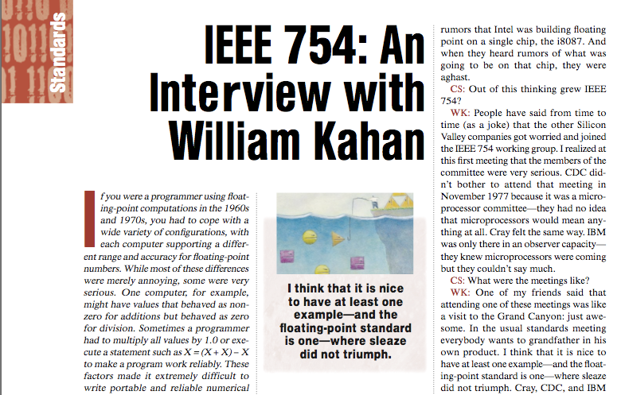
1996

Slide 6
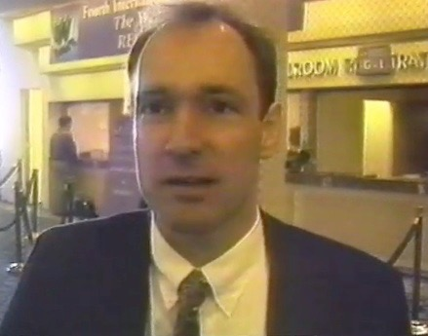
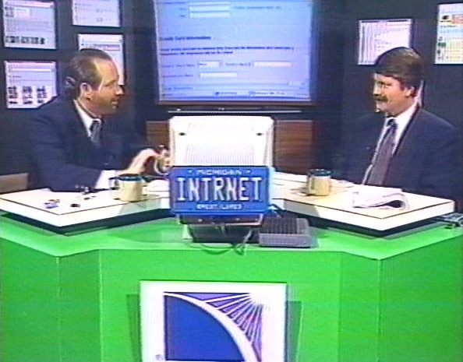
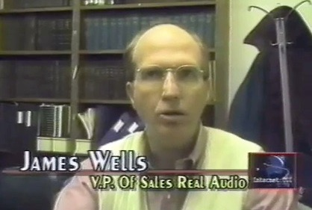
1996

Slide 7
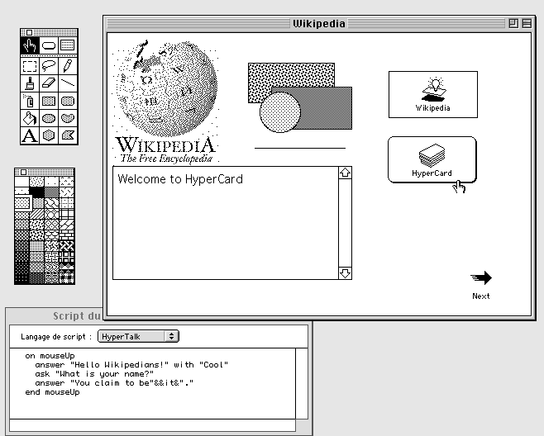
1996

Slide 8
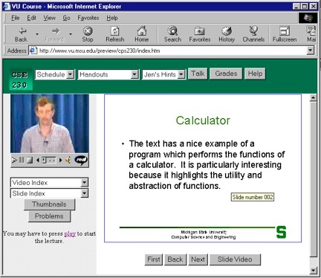
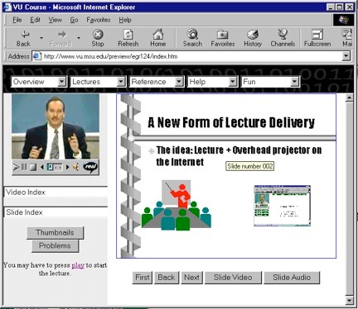
Sync-O-Matic
www.syncomat.com
1997

Slide 9
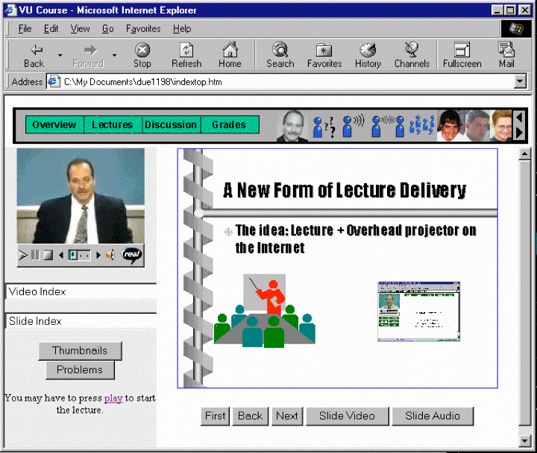
Title: Using Asynchronous, Web-based, Video to Humanize Distance Education
1998

Slide 10
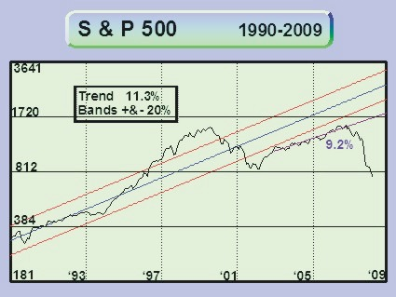
You are Here
1998

Slide 11

1999

Slide 12
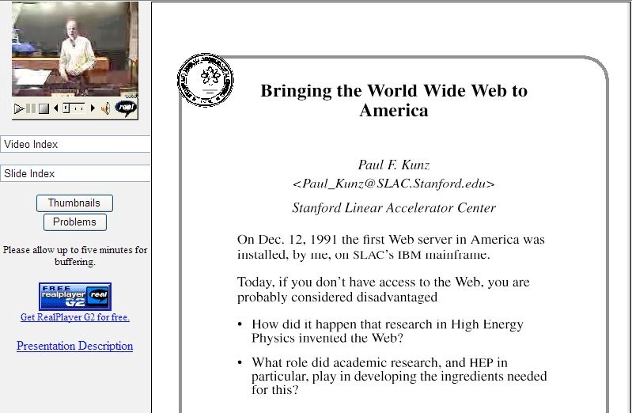
1999

Slide 13
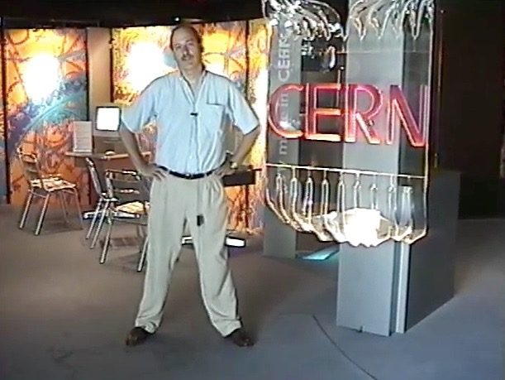
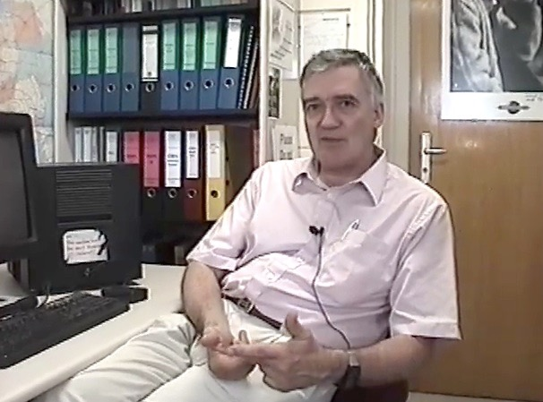
Robert Cailliau
co-Inventor of the
World-Wide Web
1999

Slide 14
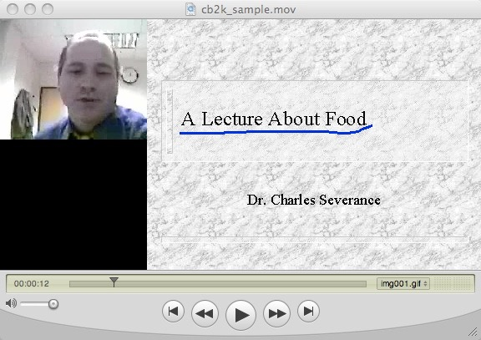
2000
http://www-personal.umich.edu/~csev/csev/projects/cb2k/index.htm

Slide 15

Microsoft Exchange + Learning Modules =
Microsoft Learning Network (MLN)
2001

Slide 16
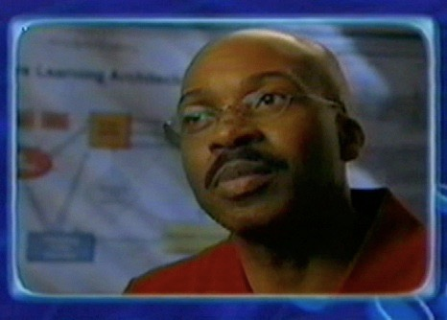
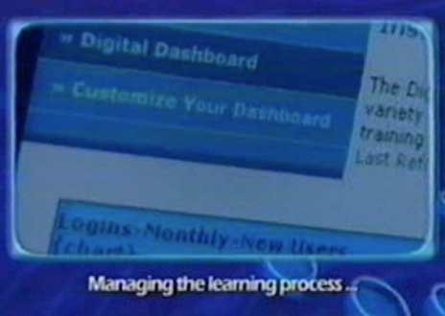
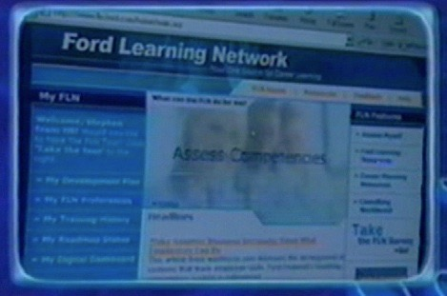

Ford Learning Network
2002
http://www.autonomy.com/content/Customers/ShowReel/case-studies/Ford.en.html

Slide 17

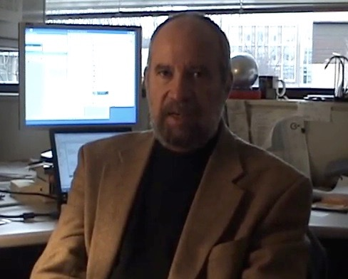
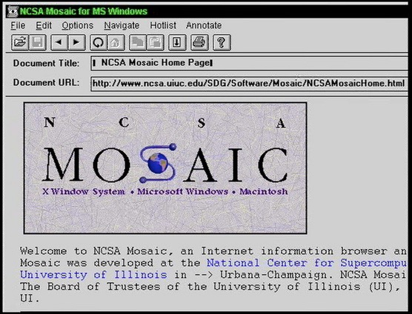
2003

Slide 18
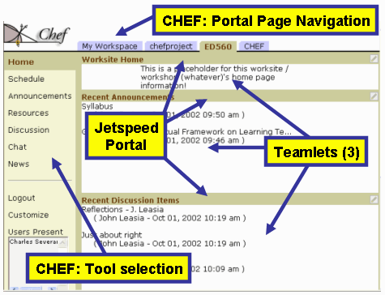

2003

Slide 19
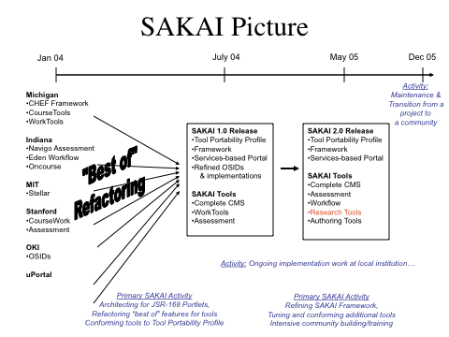
2003

Slide 20

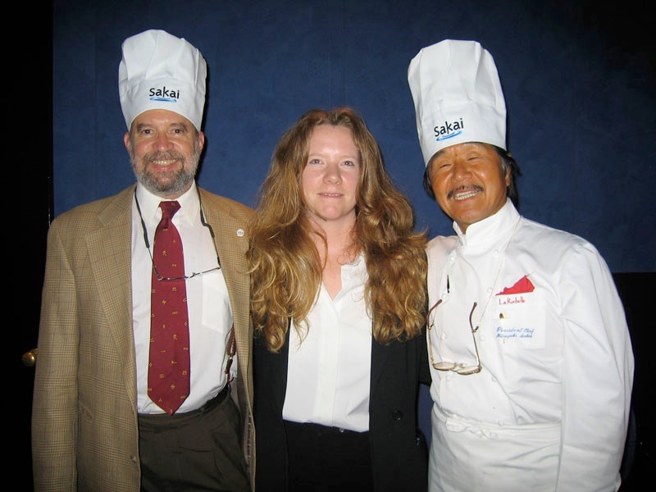
2004

Slide 21



Learning Tools Interoperability
2004

Slide 22
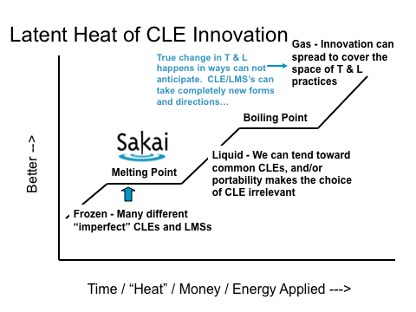
2004

Slide 23
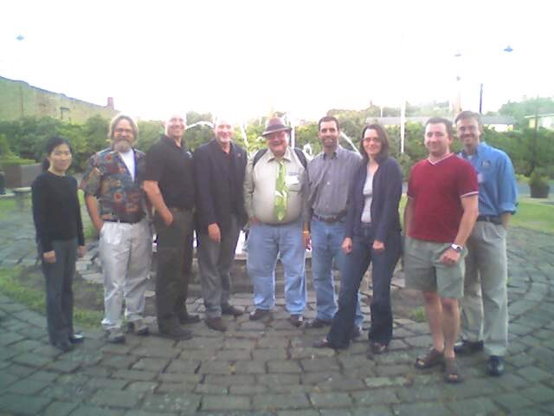
IMS Tools Interoperability
Demonstrator
Sheffield, UK
2005

Slide 24
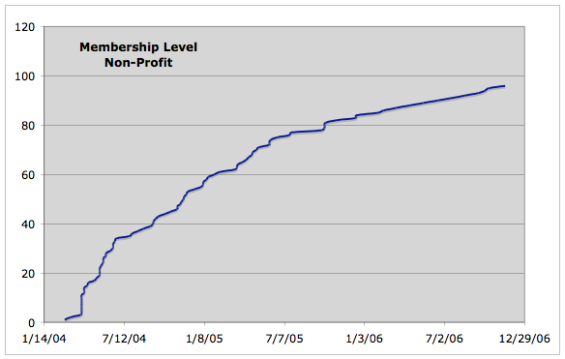


Slide 25
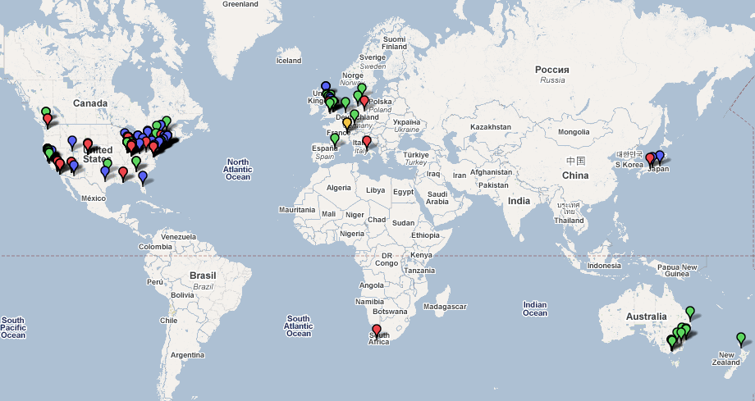


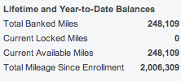
Dr. Chuck Travel 2004-2006

Slide 26
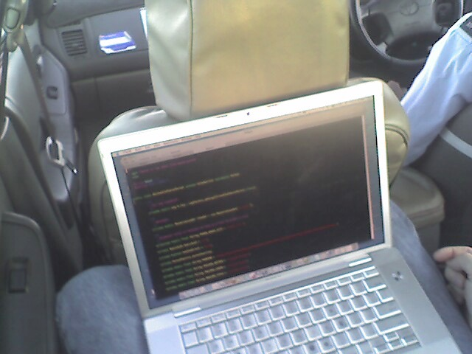

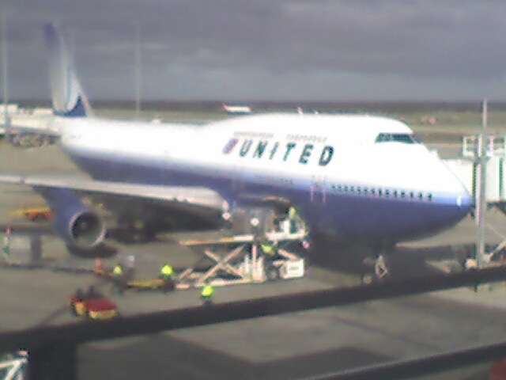
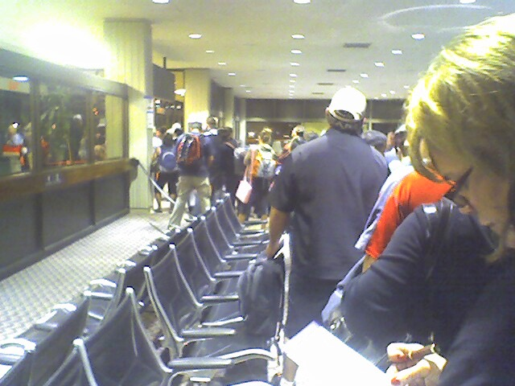
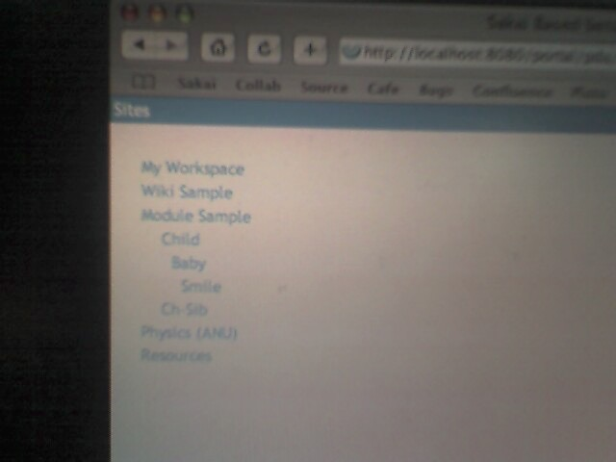
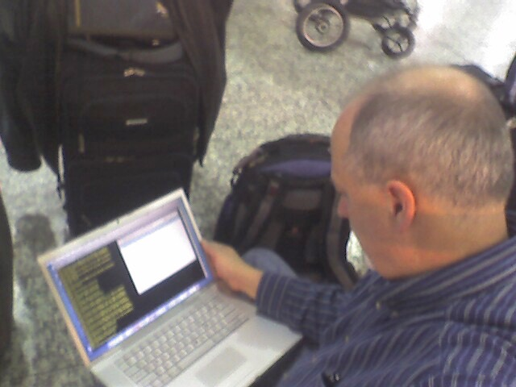
2006

Slide 27

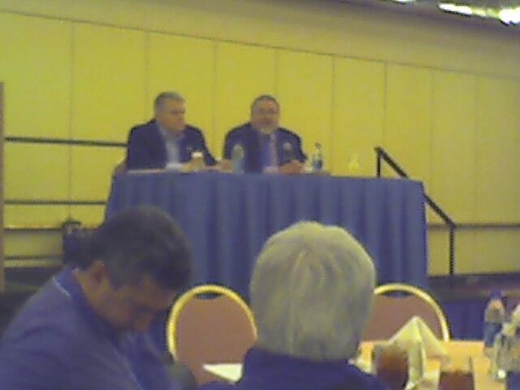
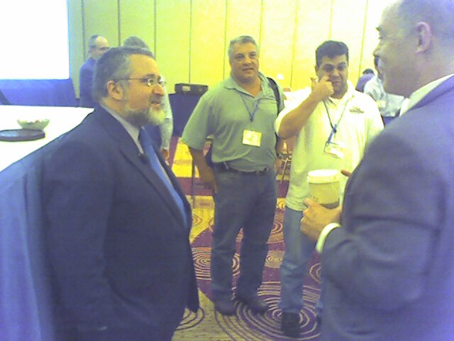
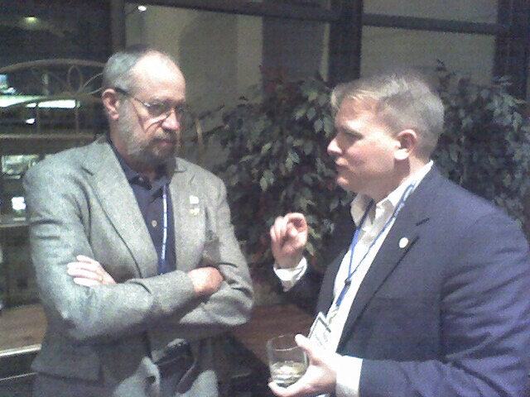
2006

Slide 28
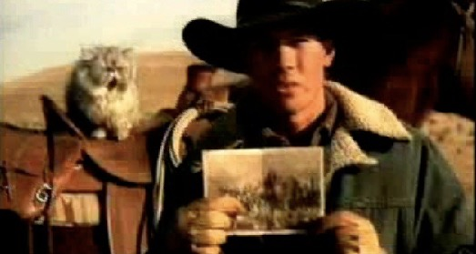
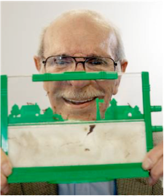
Cat Herding
2007
Ant Farm

Slide 29


Self-Service Exit Interview
Bring enterprise-level open source LMS into the Market
Collect bright worldwide developer community and achieve sufficient adoption for sustainability
Enable the rapid creation of new tools
Create a "Learning Tool App Store"
Empower teachers to write, share and use lots of tools
X
2007
X
X

Slide 30


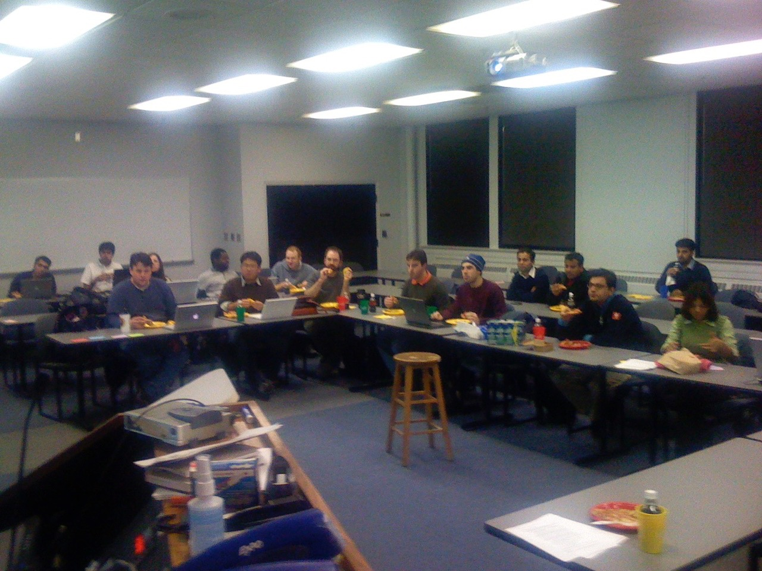
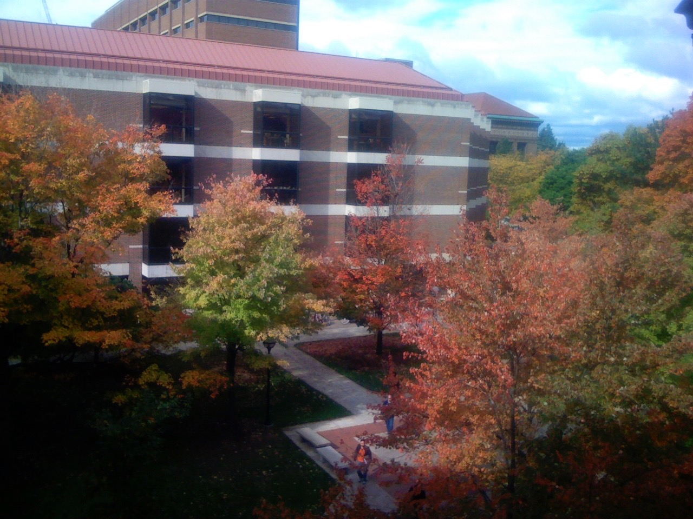
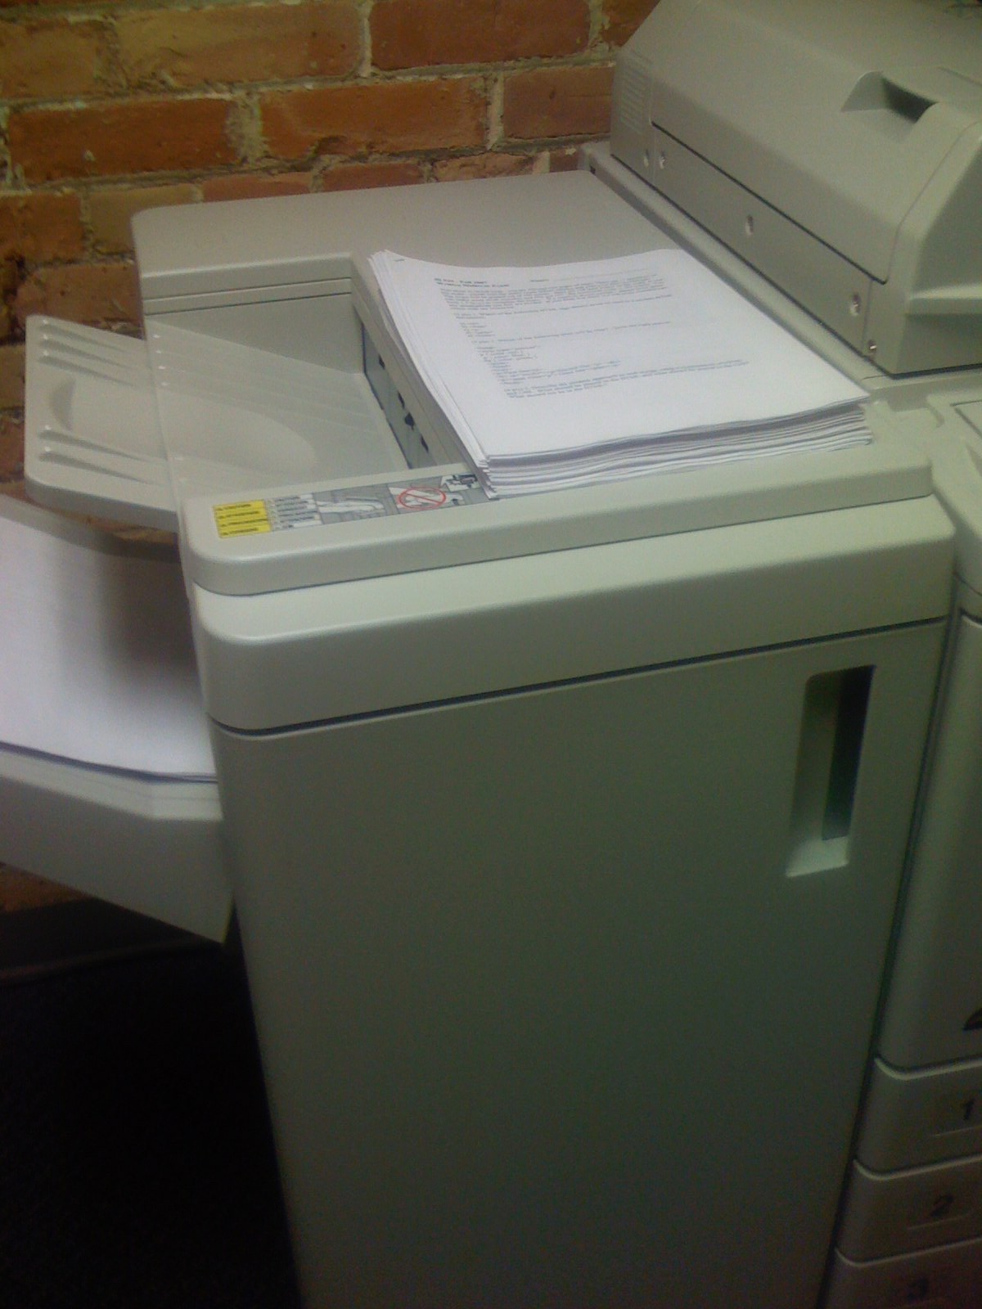
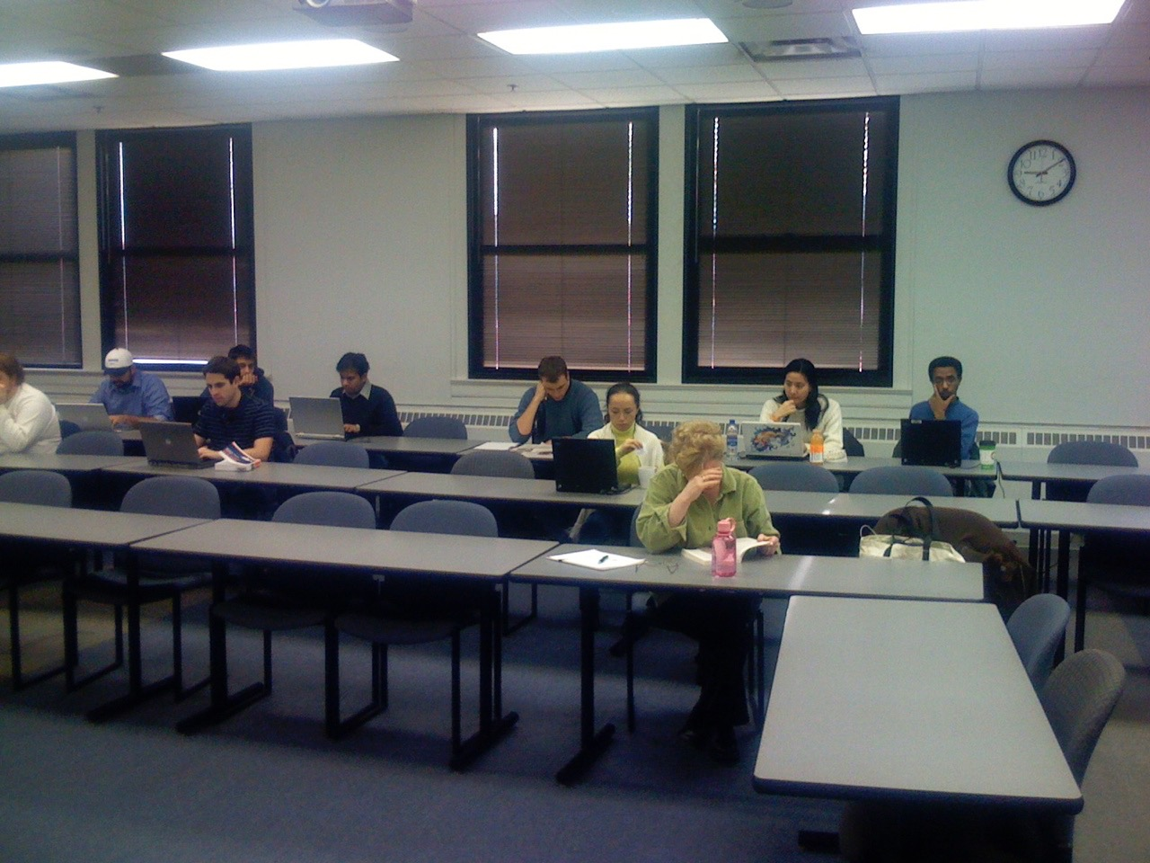
Teach
Relax
Reflect
Recharge
2007

Slide 31
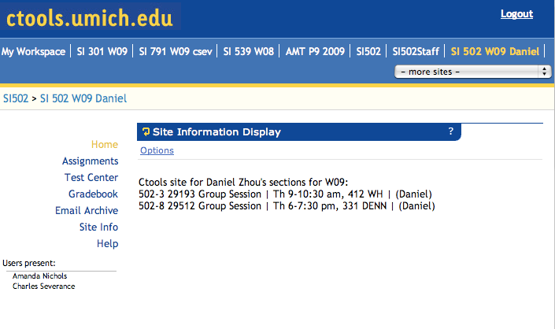

2007

Slide 32
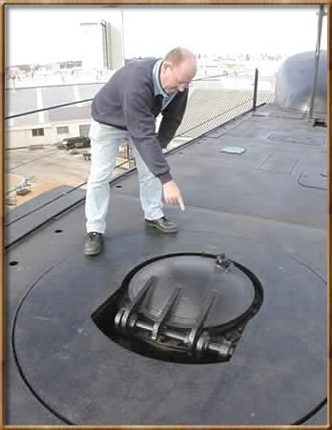
2008

Slide 33
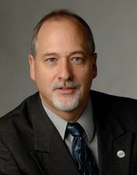
Tools
Interoperability
Commercial
Common
Cartridge
Publishers
LMS
Open Source
Standards
2008
www.imsglobal.org

Slide 34
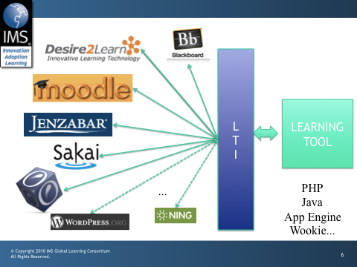

Slide 35




IMS Learning Tools Interoperability
An Evangelist Chess Game

Slide 37
Learning Tools Interoperability
Wimba and Microsoft were leading the Learning Tools Interoperability Working Group
The specification was well along - closely mirrored Wimba's cross-LMS integration approach
Wimba had hired a staff member who built a reference implementation of the draft specification
I was planning a Google Summer of Code Effort to implement the specification in Sakai (both code and PR)
February 2008

Slide 38
Blackboard and Pearson
Blackboard approached us and offered us the IP for their upcoming "Proxy Tool" which was to be part of the Blackboard 9 release
It was more robust than the Wimba approach and lining up with the market leader (and Wimba's largest partner) seemed wise
The staff person from Wimba nearly quit and Wimba slowly reduced its leadership and suport - Blackboard and Pearson took over the working group
From a maturity perspective, it was "back to the drawing board"
March 2008

Slide 39

Enter "Simple LTI"
I had a Google Summer of Code in-flight for Sakai and Moodle
So I invented a non-specification that was a bit of Wimba and a bit of Blackboard - I called it Simple LTI and promised it would be "temp"
Marc Alier (Moodle committer) made the "Dinosaur Video"
http://www.vimeo.com/7825070
March 2008 - July 2008

Slide 40


Slide 41
Educause 2008
Microsoft put up funds to build an open-source reference implementation of IMS Common Cartridge and Simple LTI
www.mirlearn.com
IMS Common Cartridge + Simple LTI Demonstration at Educause
LMS: "Microsoft" and Angel
Content: Pearson and McGraw-Hill
November 2008

Slide 43
Basic LTI is "Almost Ready"
Learning Tools Interoperability had progressed nicely under the leadership of Blackboard and Pearson
We decided to build "Basic LTI" which has the scope of Simple LTI but perfectly aligned with LTI
IMS funds a reference implementation of Basic LTI in Java and PHP
Work on Sakai support for Basic LTI begins using the reference implementation - In production at UMich January 2009
December 2008

Slide 44
Summer Fun 2009
Blackboard purchases Angel May 2009
Steven Vickers, of Edinubrgh builds open source Basic LTI Building Block for Blackboard and PowerLink forWebCT - with assistance and support from Blacboard
Work begins on a Moodle 1.9 module for Basic LTI
June 2009

Slide 45



Slide 46
Educause 2009
We have working Basic LTI for Sakai, Blackboard, and WebCT and do a number of demos including one at the Blackboard booth.
Desire2Learn ships Basic LTI in their 8.4.2 release as a patch and issues a press release
October 2009

Slide 48
Closing In...
The LTI Working Group put the finishing touches on the Basic LTI specification and starts "Internal Draft Review" for all IMS Members
IMS funds the develoment of a Basic LTI certification test
Moodle 2.0 agrees to include Basic LTI out of the box
I visit Zurich and build a Basic LTI tool and contribute it to OLAT
Penn State University Starts work on open source Angel Nugget
March 2010

Slide 49



Slide 50
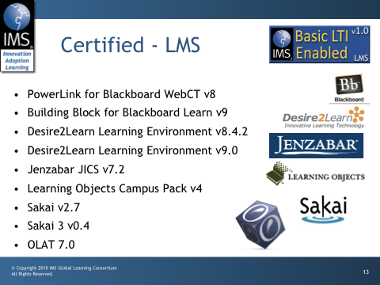
May 2010

Slide 51
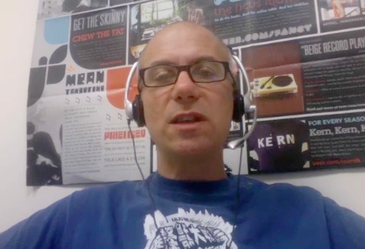


What's Next?
Promote Basic LTI to Tool Writers
http://videos.noteflight.com/MoodleBasicLTI.mov
Get Moodle 2.0 shipped with Basic LTI
Encourage Blackboard to include Basic LTI in a release

Slide 52
Enagaging open source, standards, engaging propretary vendors, evanglizing ideas, all are important activities...
my long-term goal is to empower teachers and learners as to how they select and use technology to help themselves teach and learn...

Slide 53
My technical objective is to make it so that teachers can easily trade software and content between each other (like virtual baseball cards).
Regardless of what learning management system (or systems) their institution has adopted.

Slide 54
Thank You
Dr. Charles Severance
University of Michigan School of Information
www.dr-chuck.com

